Slide 1
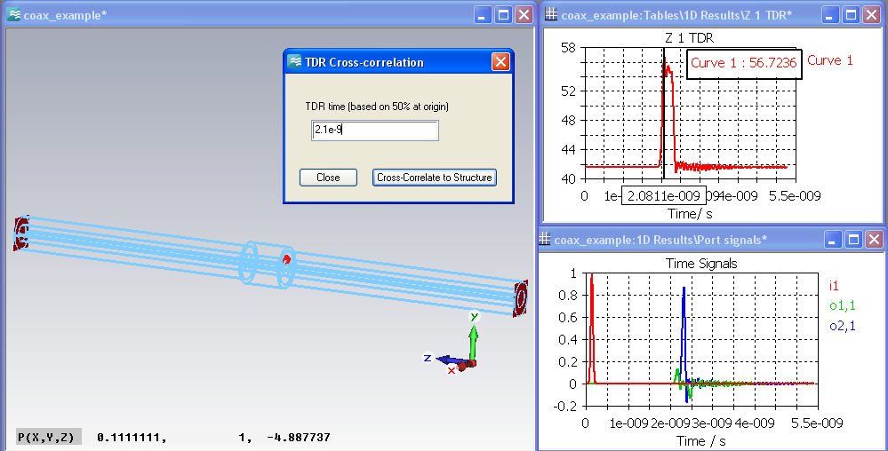
Automatic TDR Cross-Probing
2
1
Macro runs in the background and evaluates the power flow monitor
Get Time from TDR Plot
3
Highlights a point that causes the Impedance

